Slide 1


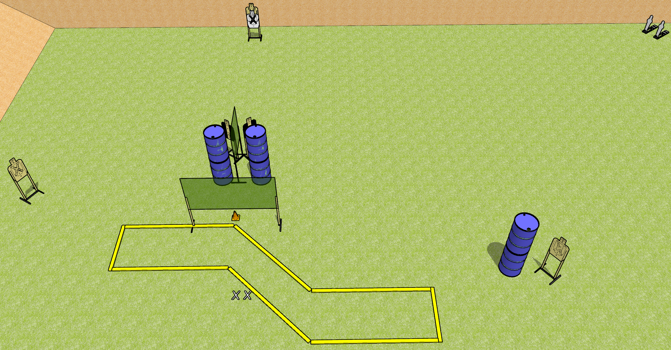
 | Dothan Gun Club – USPSA Match Long Shots Course Designer : Drew Coleman
START POSITION : Standing with both feet on X’s, wrists below belt
GUN READY CONDITION : Pistol loaded and holstered. PCC loaded, shouldered, safety on, pointed at orange cone. |  | SCORING: Comstock, 12 rounds TARGETS: 5 paper, 2 Steel SCORED HITS: Best 2 on paper, steel until down START-STOP: Audible, last shot RULES:
STAGE PROCEDURE: Engage targets as they become available from within the fault lines.

Slide 2
Long Shots
Written Stage Briefing
Long Shots is a 12 round, 60 point, Comstock short course. There are five USPSA targets and two mini poppers. The best two hits on paper will score, and steel must fall to score. The start signal is audible.
Handgun start position is standing with both feet on X’s, hands relaxed at sides. Handgun is loaded and holstered.
PCC start position is standing with both feet on X’s, muzzle pointed at orange cone. Loaded carbine is held with both hands, shouldered, safety on.
On start signal, engage targets as they become available from within the fault lines.

